Slide 1
Industry Orientation Project Report
On
“Customer Satisfaction”
At
“Sunil Auto Agency”
Submitted to
Noble group of institution, Junagadh
(Semester VI)
Under the guidance of
Prof. Drashti Vaishnav
Submitted by
Vivek kotecha :-207380571041
Mehboob Motiwala :-207380571044

Slide 2
Flow of presentation
Introduction
Industry’s growth
Top 10 companies in Automobile industry
Porter’s Five Force
Company chosen
SWOT Analysis
Literature Review
why is this research conducted?
Research Methodology
Results of research
Limitations of research
To conclude
Bibliography

Slide 3
Introduction
Automobile – an important part of our lives, which reflects an evolution of the auto that happens worldwide.
The motorcar business has become one of the biggest purchasers among many of the key industrial products.
1769- creation of steam engine automobiles capable of transport of human lives.
1806- the first car was powered by an internal combustion engine running on fuel gas.
1885- introduction of modern gasoline or petrol fueled internal combustion engine.

Slide 4
Industry’s growth
In world:
Is supported by various factors such as the availability of skilled labor at low cost, robust R&D centers, and low-cost steel production.
In India:
Largest tractor manufacturer, second-largest bus manufacturer, and third largest heavy trucks manufacturer in the world.

Slide 5
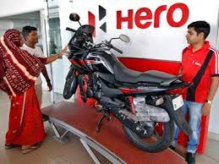
Industry’s growth
In Gujarat:
Gujarat currently presents an opportunity of billions of Rupees for several component manufacturers and this has further accelerated the growth of upcoming manufacturing facility for component manufacturers.

Slide 6
Top 10 companies of Industry
Bajaj Auto Ltd.
Ashok Leyland Ltd.
Mahindra & Mahindra Ltd.

Slide 7
Top 10 companies of Industry
Tata Motors Ltd.
Ford Motor Company.
Hyundai Motor Ltd.

Slide 8
Top 10 companies of Industry
Maruti Suzuki .
TVS Motor Company Ltd.
Force Motors Ltd.

Slide 9
Porter’s Five Force Threat of new entrants (low)
For entering any market, huge capital is required.
New entrants can easily access suppliers and distributors
It is difficult for customers to trust new company without experiencing new products.
Automative companies have well established reputation
Legal barriers can save companies from new entrants, because it is very specific industry

Slide 10
Bargaining power of suppliers (Low)
Power of suppliers is relatively weak.
There are very large number of suppliers present.
The availability of substitute is quite higher, which can ultimately be a threat to supplier.
Automobile companies do not rely only on one supplier.

Slide 11
Threat of substitutes (Low)
The threat of substitutes in this industry is not very great.
The availability of alternative modes of transportation is more (trains, buses)
These alternative modes may or may not provide same level of convenience, freedom or value.

Slide 12
Bargaining power of buyers (High)
There are numerous buyers in the market.
Buyers have lot more alternatives, which allows them to switch over any other modes easily, quickly and inexpensively.
They switch in order to receive the best bargain.

Slide 13
Industry Rivalry (High)
There are moderate number of competitors.
Size of competing firms is not actually the same, they usually compete for different consumer segments.
Customers are quite loyal to their brand and while the industry is large, it has matured.
With higher competition, brands are trying to maximize customer satisfaction and competing to provide the best customer experience.

Slide 14
Company Chosen
Name of Showroom: | Sunil Auto Agency.
Year of Establishment | 1998
Owner: | Sunilbhai Adatiya
Main Product: | Automobiles (2 wheeler)
Address: | Sunil Auto Agency, Opp. Chandni Gift Store, Junagadh Road, Jetpur 360370.
E-mail ID | sunilautoagency@yahoo.com
Contact No. | 9687617995
No. of employees | 15
Showroom time | 9:00 am to 8:00 pm
Distribution | Jetpur Taluka
Tag Line | “Hum Main Hai Hero”
Tie-up with bank for loan | HDFC, ICICI, AXIS.

Slide 15
SWOT Analysis
SWOT ANALYSIS
STRENGTHS:
Huge brand equity.
Wider range of products on every segment.
Excellent distribution.
WEAKNESSES:
Low on design and innovation.
Almost all its products have similar features.
Imports of its spare parts is higher.
OPPORTUNITIES:
Can increase exports of bikes to international markets.
One of the most growing industries.
THREATS:
Strong competition from Indian as well as international market.
More dependence on government policies.
Better public transport may affect its sale.

Slide 16
Product portfolio
Hero Pleasure plus
Hero Splendor plus

Slide 17
Product portfolio
Hero Thriller
Hero Maestro Edge

Slide 18
Literature Review
Vishnu Kumar Umrao(2021) | A customer satisfaction study should begin by asking about the factors affecting customer satisfaction, how important those factors are for the whole, and the level of customer satisfaction. A problem with customer satisfaction surveys (Naumann, 1994) is that a poor customer satisfaction programme yields vague data and raises customer expectations. If customer expectations are raised and a company's performance remains the same, the customer's overall satisfaction will decrease

Slide 19
Literature Review
Kunal Patel & Anuradha Pathak(2022) | The objective of the study is to study the customer’s satisfaction level towards products of Hero MotoCorp demographically, to study factors that lead to consumer satisfaction, to study about the knowledge of people of Navsari city towards products & service of Hero MotoCorp across occupation, to study overall consumer satisfaction towards services offered by the company. For this research data are collected from the questionnaire which was being filled up by the customers who purchased vehicles from Metro Motors Navsari. After collecting the data through questionnaire I have come to know about how the customers are satisfied or dissatisfied with company.

Slide 20
Literature Review
Preet Kamlesh Patel & Taral Patel(2020) | Customer satisfaction is the key factor for successful and depends highly on the behaviors of frontline service providers. Customers should be managed as assets, and that customers vary in their needs, preferences, and buying behavior. This research was conducted to Study Customer Satisfaction towards Products of Hero Motocorp. The results show that people are less satisfied with deluxe, extreme and glamour bike so they have to improve that product.

Slide 21
Literature Review
Franklin & Selvi, (2017) | Study of consumer satisfaction between Hero and Bajaj bikes is an attempt to know the factors that influence the public for their preference on using the Bike. All findings and suggestions made during study are supported by the researches during the period of research. It is hoped that the study would highlight the fields of marketing strategy followed by the companies.

Slide 22
Literature Review
D.Vijayalakshmi, Kumari & Deepika (2015) | A study has been undertaken to check the satisfaction level of the shoppers towards chosen branded 2 wheelers in south Coimbatore town. Hero, TVS, Suzuki, Bajaj, Honda, Mahindra Royal Enfield and Yamaha are the popular brands within the Two-wheeler industry.

Slide 23
Objectives of Study
To measure the satisfaction level of customers towards our product.
To understand what influences the decision to purchase our product.
To know perceptions of customers regarding our product.
To get superiority of customer retention and loyalty.

Slide 24
Research Methodology
Research design | Descriptive
Method of Research | Survey method
Type of Questionnaire | Structured Questionnaire
Sampling method | Non probability, Convenience sampling
Sample size | 174 Samples
Sample Area | Saurashtra

Slide 25
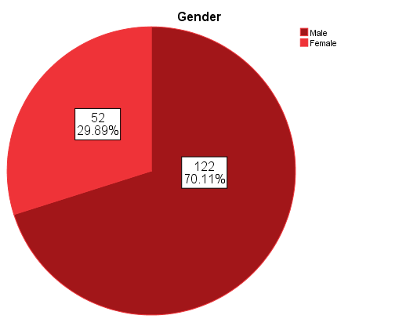
Data Analysis
Gender
Chart displays ratio of male to female, where we had 70.11% of male respondents and rest were female respondents. The total number of those who responded will be used as a total sample size.

Slide 26
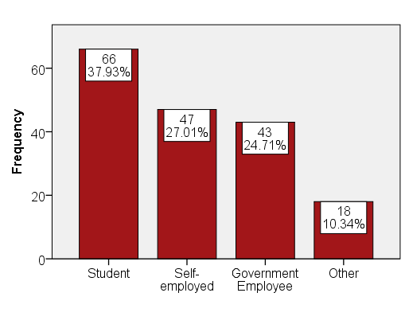
Data Analysis
Occupation
Above table shows the occupation of respondents, and most of them were students with 37.9% and least were others (10.3%).

Slide 27
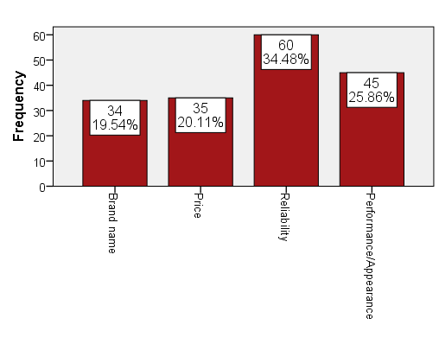
Data Analysis
What influenced your decision to purchase the Hero MotoCorp Automobile?
From the above bar graph, it can be interpreted that, respondents’ buying decision rely more on reliability (34.48%) of its products.

Slide 28
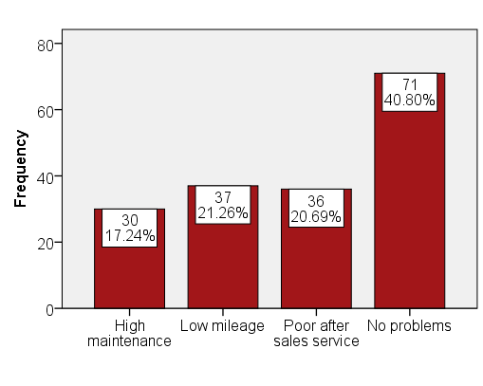
Data Analysis
Any problem faced after purchasing Hero Motocorp Automobile?
From the graph it is inferred that majority of respondents (40.80%) do not face any problems after purchasing Hero MotoCorp’s products.

Slide 29
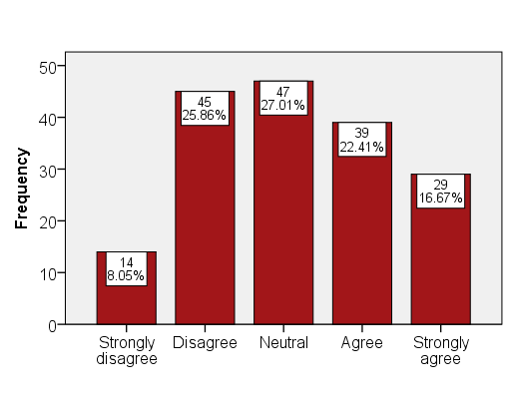
Data Analysis
I can get affordable finance option to buy the bike at Hero MotoCorp.
From the bar graph, it can be inferred that respondents show neutral response (27.01%) on getting an affordable finance option for buying its products.

Slide 30
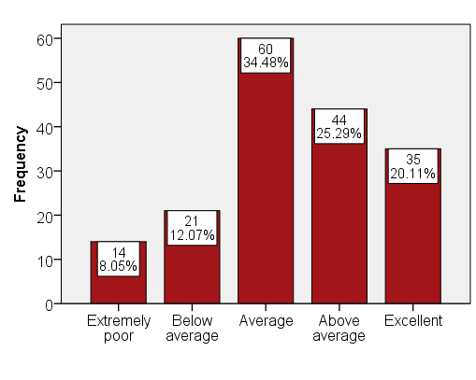
Data Analysis
Overall how will you rate the Hero MotoCorp Automobile?
From the bar graph and average result (34.48%) it can be inferred that, respondents do not really suggest to buy its products.

Slide 31
Results of research
In this research, majority of customers are male. Out of 174, 122 were males and 52 were females. Majority of customers out of 174 covered under 18 to 25 age criteria.
According to research, Majority of customers comes under student category as well as engaged with self employed and very less only 18 customers come under other.
Almost majority of the people Dissatisfied with the fuel tank and classic look of the product. Company’s After sales service ,speed , price and power pickup has matched the satisfaction level of the customers.

Slide 32
Results of research
The data depicts that the customer can get affordable finance option to buy the bike at Sunil Auto is Agree in customers eyes.

Slide 33
To conclude
It can be concluded from the study that consumers are attracted towards the purchase of motorcycles due to modern outlook represented through motorcycles and advanced from the earlier two-wheelers.
This research study was conducted with the aim to find the satisfactory level of customers in Hero MotoCorp Automobile and it is found that most of the customers are satisfied with the Hero MotoCorp.
Although, if the company can change the product style and reduce the cost of the product, can be attracted by more customers and get full satisfaction.

Slide 34
To conclude
Majority of the customers are male youths and they use Hero MotoCorp Automobile mainly for daily uses and city touring.
Customers are satisfied with the affordability of service charges and timely delivery.

Slide 35
Bibliography
https://ijrpr.com/uploads/V3ISSUE4/IJRPR3340.pdf
http://aegaeum.com/gallery/agm.j-3339.110-f.pdf
https://www.ijresm.com/Vol.3_2020/Vol3_Iss4_April20/IJRESM_V3_I4_163.pdf
http://dspace.christcollegeijk.edu.in:8080/jspui/bitstream/123456789/1138/34/CCASBCM102.pdf
https://ijmr.net.in/current/2019/OCTOBER,-2019/1NqHtQ96oYdZHNa.pdf

Slide 36
THANK YOU ☺

